Slide 1

PeerVerse – A Peer-to-Peer Mentorship Platform Using Modern Web Technologies.
Project Presentation
MITU22BTCS0484 : Ninad Khopade
MITU22BTCS1024 : Yash Bhardwaj
MITU22BTCS0799 : Shriyanshi Jain
MITU22BTCSD033 : Madhusudan Ladda
Guided by
Prof. Mayuresh Gulame
Department of Computer Science & Engineering, MITSoC, Loni Kalbhor

Slide 2
Outline
Introduction
Problem Statement
Objectives
Modules Proposed in Project Phase I
Status of module completion in Project Phase I
Modules Proposed for project phase II
Project Development Plan
Status of Project Publication, IPR,etc
Result
Department of Computer Science & Engineering, MITSoE, Loni Kalbhor

Slide 3
Introduction
1) Project Name:
PeerVerse – A Peer-to-Peer Mentorship Platform Using Modern Web Technologies.
2) Key Features:
Real-time video mentorship using WebRTC.
Instant messaging and session management via Socket.IO.
Serverless, scalable architecture with Railway backend and Vercel frontend.
Affordable mentorship model.
Equitable revenue sharing (70% mentor, 30% platform).
3) Processing Unit:
React.js frontend for responsive interface.
Express.js backend hosted on Railway for scalable deployment.
Neon PostgreSQL database for serverless, auto-scaling data management.
4) User Interface:
Intuitive web dashboard for mentor–mentee interaction.
Session scheduling and rating features for both users.
Blog and community discussion section for continued engagement.
5) Functionality:
AI-assisted mentor–mentee matching system.
Real-time video and chat during mentorship sessions.
Secure payment integration (Razorpay).
Performance analytics and session reports.
Department of Computer Science & Engineering, MITSoE, Loni Kalbhor

Slide 4
Problem Statement
Existing mentorship systems are often constrained by cost, accessibility, and scalability. Traditional counseling services require substantial financial investment and scheduling effort, which limits their reach among students and early-career professionals. Additionally, many available mentorship programs lack a robust digital infrastructure capable of real-time communication and seamless interaction. There is a strong need for a system that ensures affordable, technology-enabled, and relatable mentorship opportunities that can operate effectively across different geographical regions.
Objectives
To implement WebRTC and Socket.IO for low-latency video and text communication.
To develop a serverless cloud architecture ensuring cost-efficiency and automatic scaling.
To provide an easy-to-use dashboard for users to schedule sessions, make payments, and exchange feedback.
To promote a digital community for continuous learning and professional growth.
To design a peer-to-peer mentorship platform that enables meaningful, affordable, and real-time interactions.
To create a reliable system that can be adapted for academic, career, and skill-based mentorship.
Department of Computer Science & Engineering, MITSoE, Loni Kalbhor

Slide 5
3. Modules Proposed in Project Phase I
User Registration & Login System
Mentor and Mentee Profile Management
Mentor-Mentee Matching System
Chat & Messaging System
Session Scheduling System
Real-Time Video Calling Module
Payment Integration Module
Department of Computer Science & Engineering, MITSoE, Loni Kalbhor

Slide 6
4. Status of Modules Completed in Project Phase I
User Registration & Authentication – Completed
Profile Management – Completed
Chat & Messaging System – In Progress
Basic Video Calling – Completed
Dashboard UI – Completed
Session Scheduling – In Progress
Payment Integration – In Progress
Recommendation System – In Progress
Department of Computer Science & Engineering, MITSoE, Loni Kalbhor

Slide 7
5. Modules Proposed for Project Phase II
AI-based Mentor Recommendation System
Analytics & Reporting Dashboard
Multilingual Support
Career Guidance Module
Community Discussion Forum
Certification & Feedback System
Department of Computer Science & Engineering, MITSoE, Loni Kalbhor

Slide 8
6. Project Development Plan
Methodology includes requirement analysis, system design, development, and iterative testing for continuous improvement.
A survey of 500+ students and professionals helped identify the key challenges in mentorship accessibility and engagement.
Utilizes modern web technologies – React.js for frontend, Express.js for backend, and PostgreSQL for secure data storage.
The concept is based on digital peer mentorship, where individuals with shared experiences guide and support each other.
Employs Agile development model, ensuring flexibility, adaptability, and rapid feedback integration.
Real-time communication is achieved using WebRTC (media stream) for video and Socket.IO (data signaling) for synchronization.
Focuses on performance optimization, data privacy, and seamless deployment using serverless architecture tools.
Integrates AI-based analytics to assess mentorship effectiveness and provide personalized mentor suggestions.
Incorporates modular code architecture to simplify updates, maintenance, and scalability for future platform expansion.
Department of Computer Science & Engineering, MITSoE, Loni Kalbhor

Slide 9
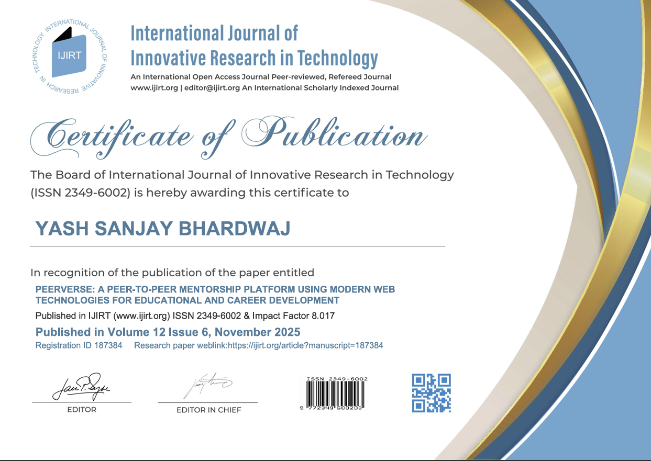
7. Status of Paper Publication, IPR, etc.
Department of Computer Science & Engineering, MITSoE, Loni Kalbhor

Slide 10
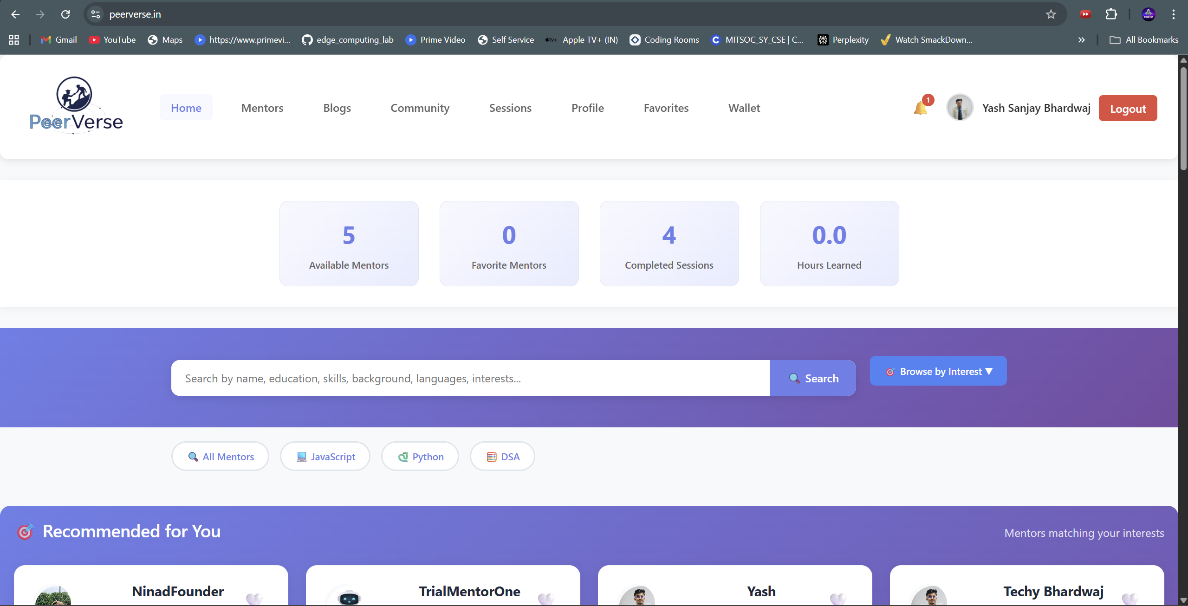
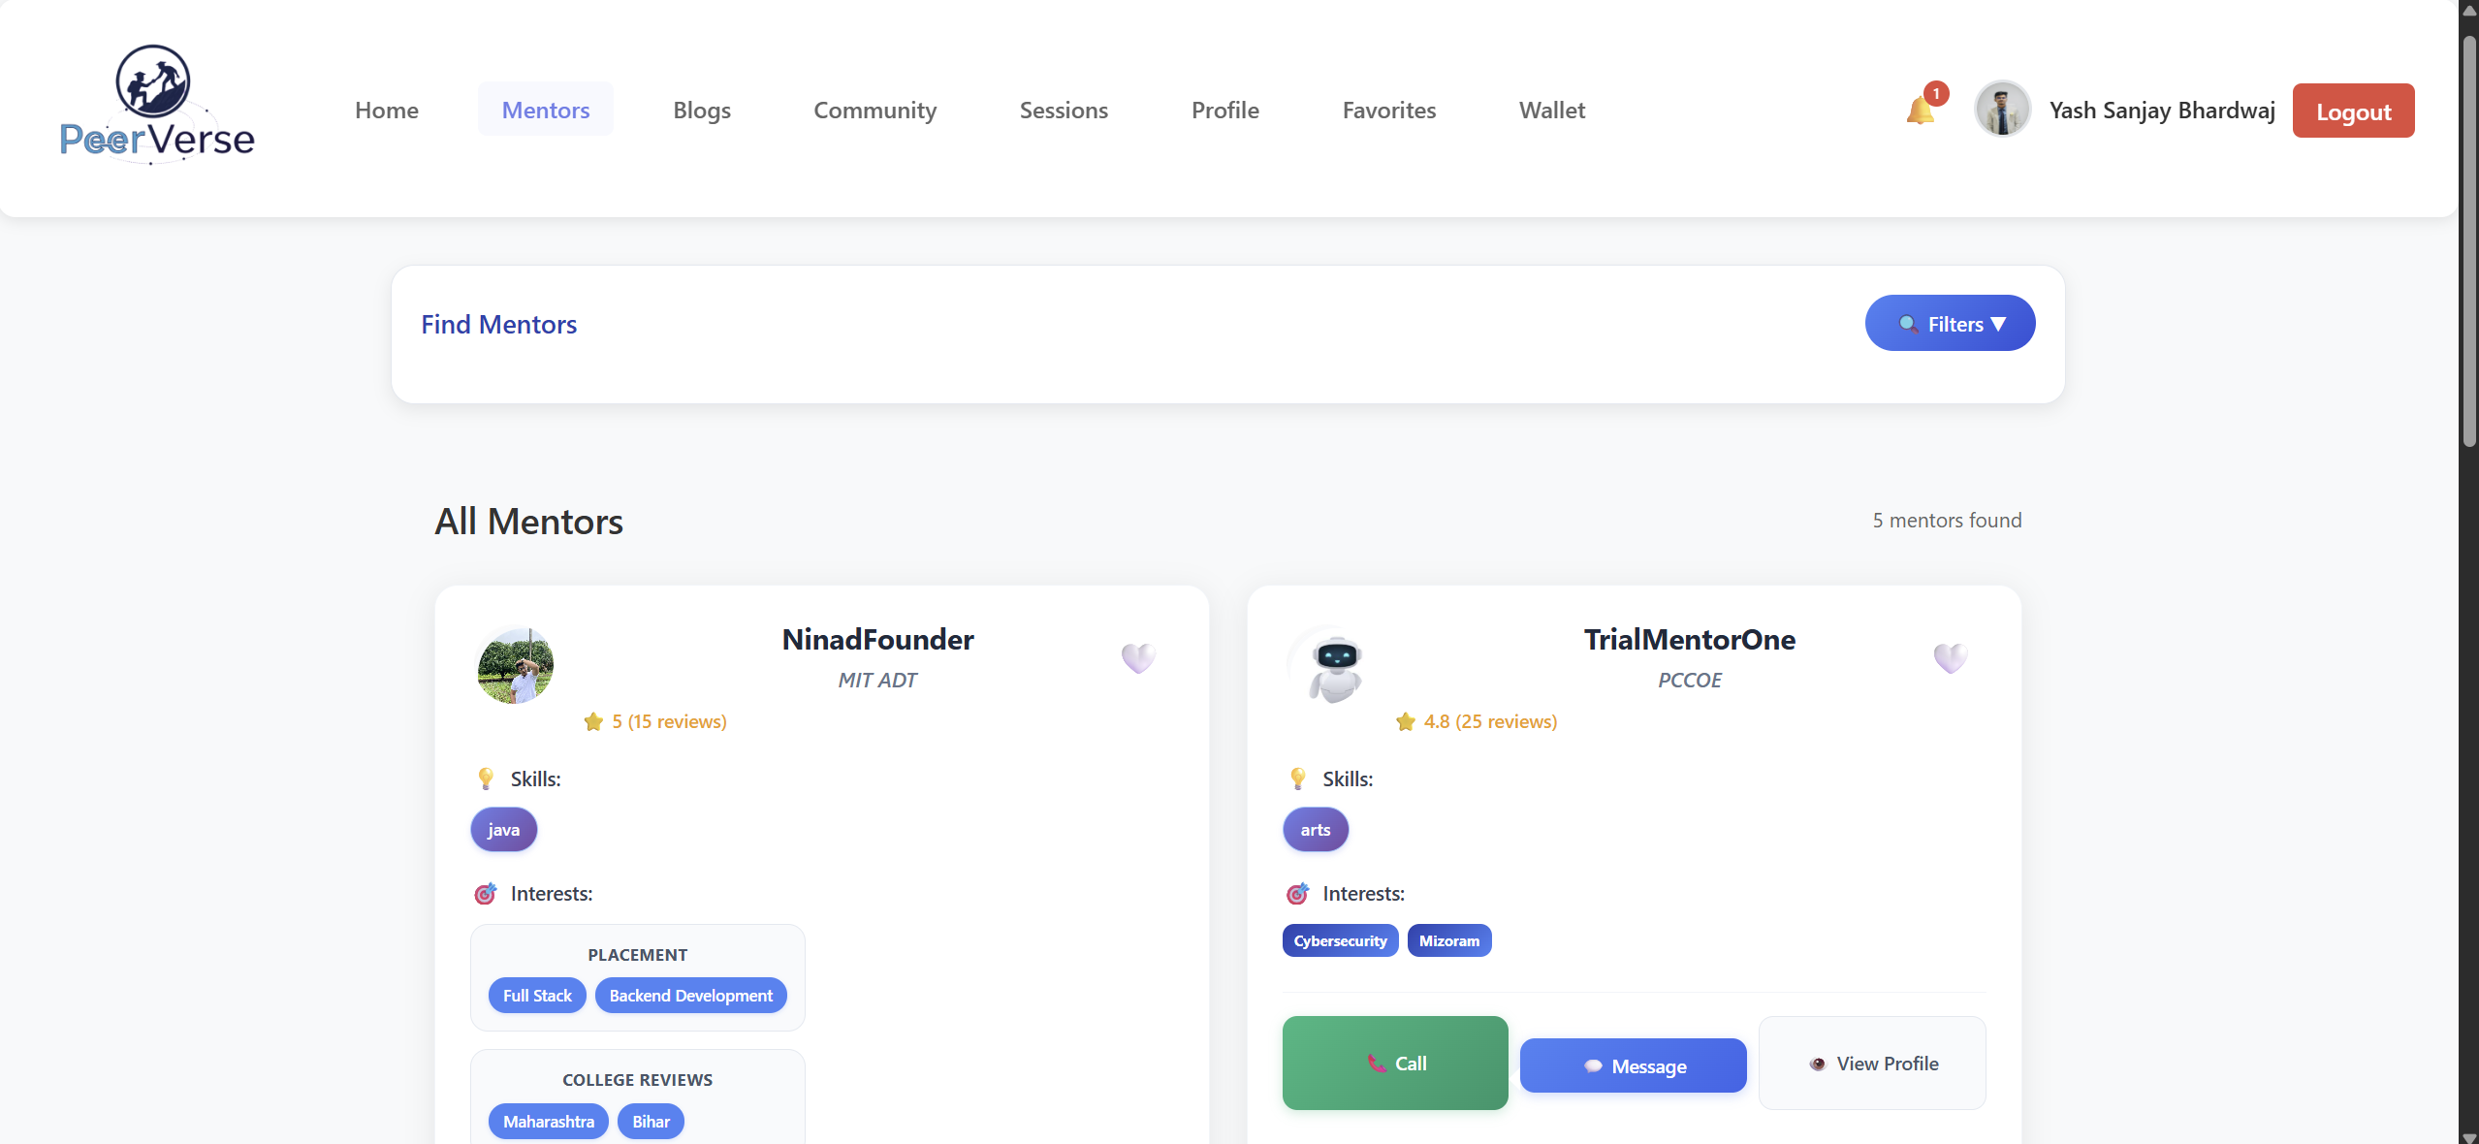
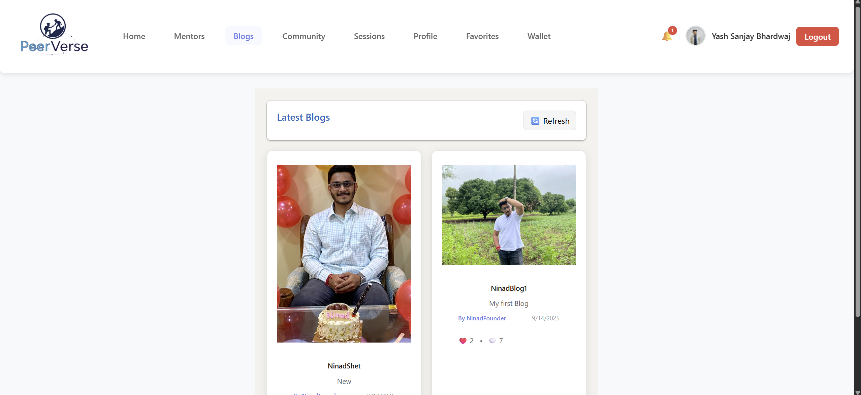
Results
Department of Computer Science & Engineering, MITSoE, Loni Kalbhor

Slide 11
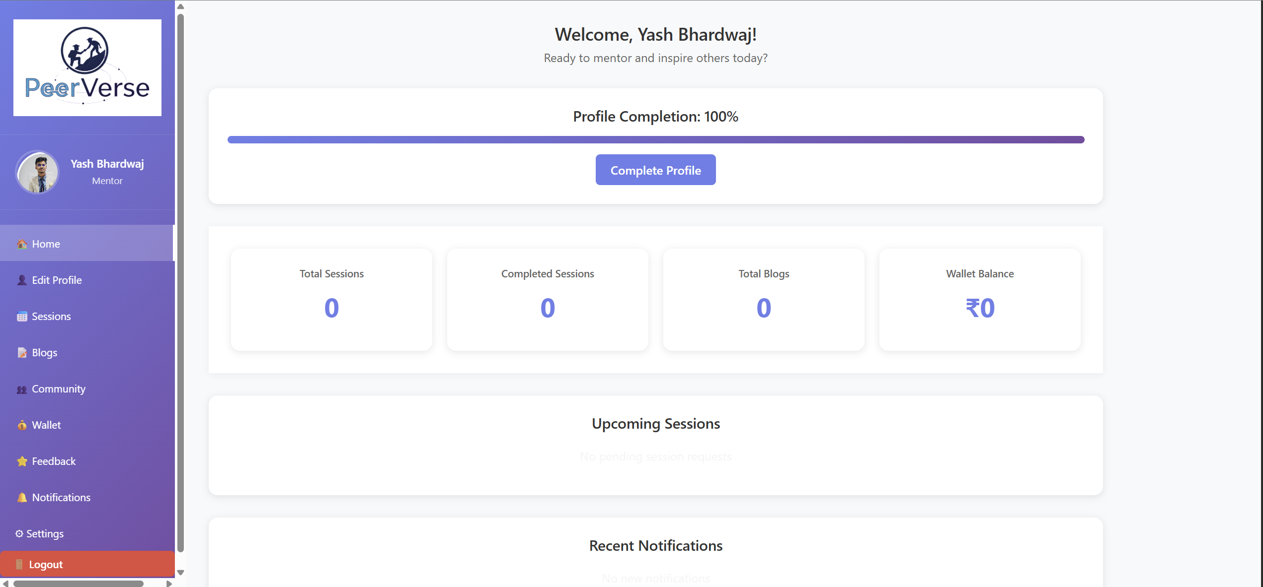
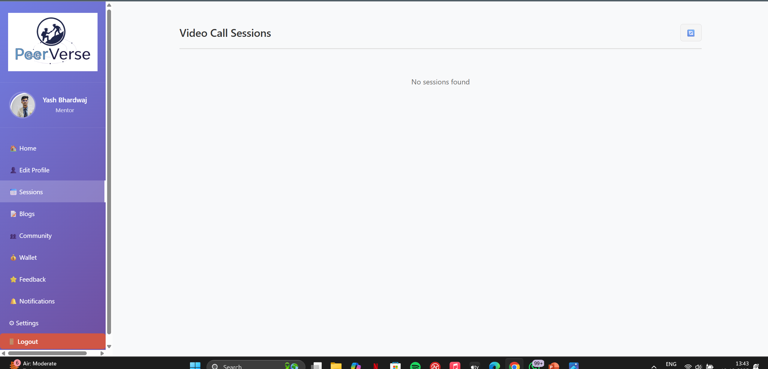
Results
Department of Computer Science & Engineering, MITSoE, Loni Kalbhor

Slide 12
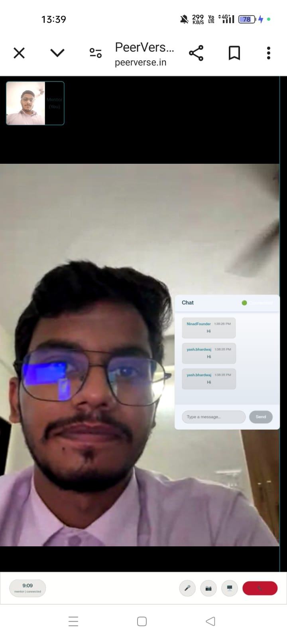
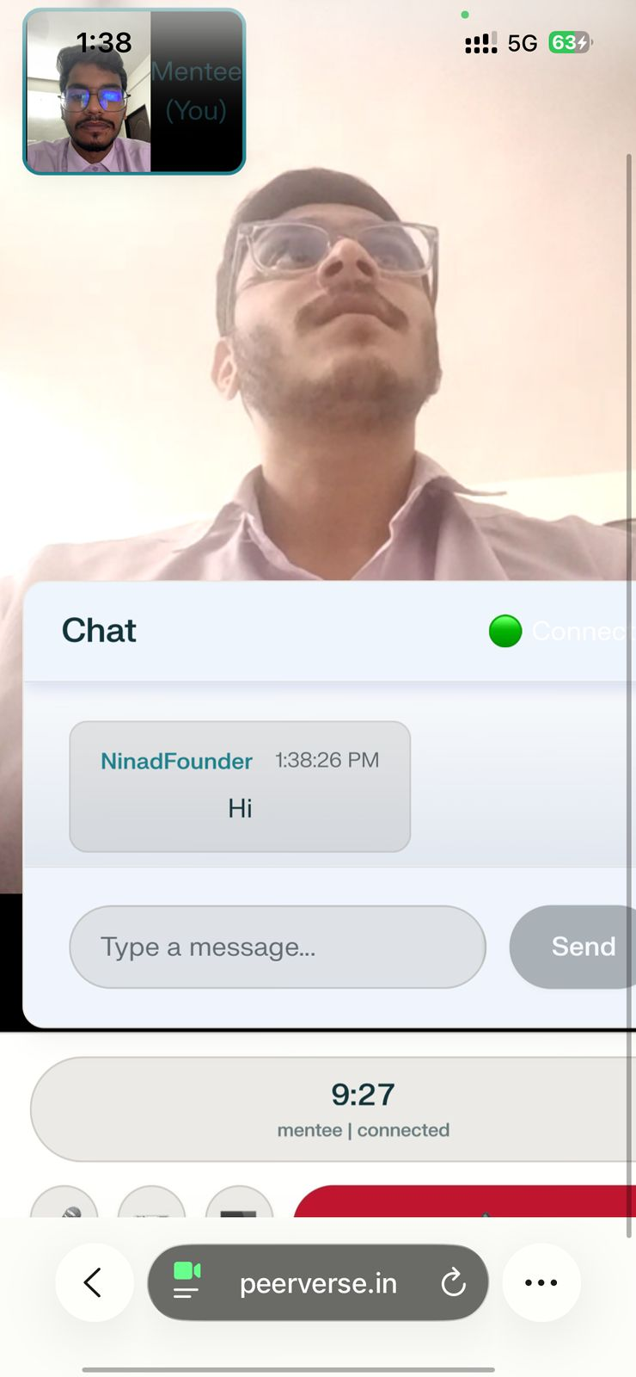
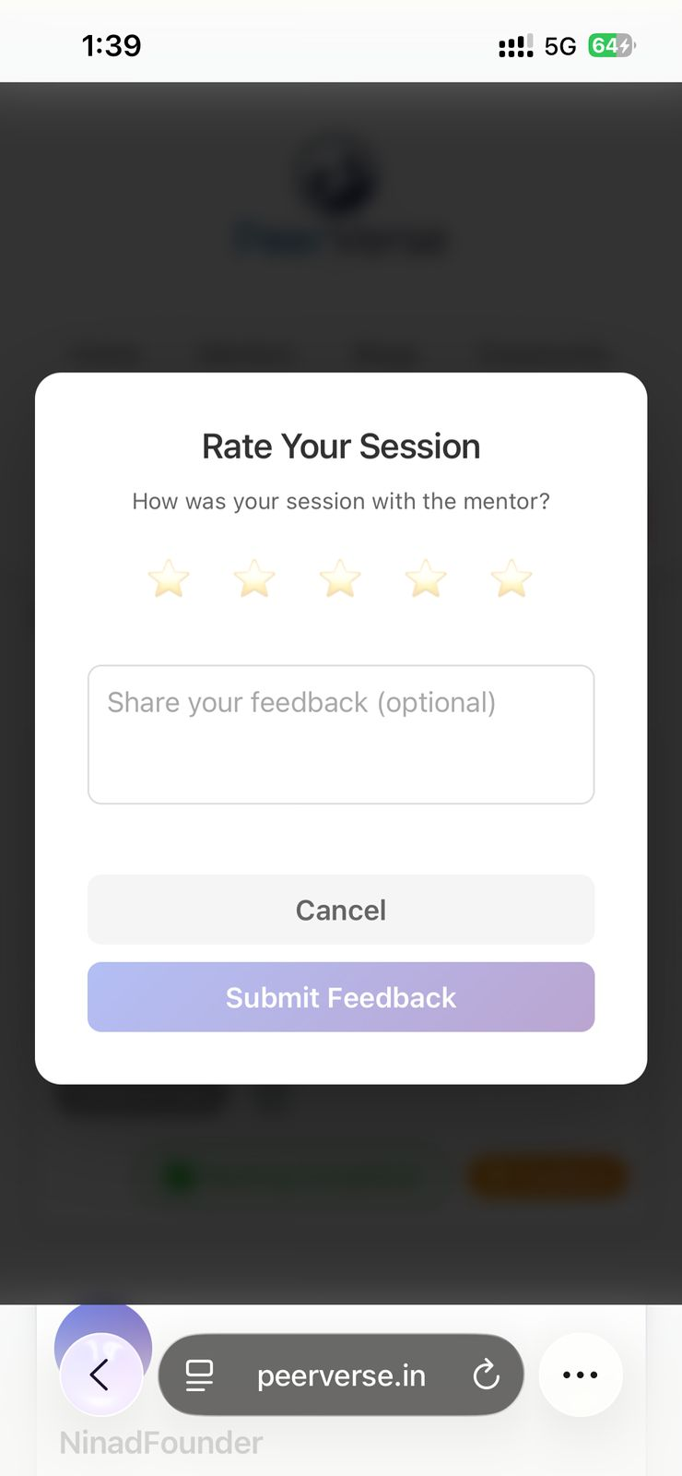
Results
Department of Computer Science & Engineering, MITSoE, Loni Kalbhor

Slide 13
Thank You
Department of Computer Science & Engineering, MITSoE, Loni Kalbhor

Slide 14
Questions
Department of Computer Science & Engineering, MITSoE, Loni Kalbhor

